Slide 1
Action Team – Behavioral Health
Laramie County Community Partnership
October 12, 2021

Slide 2
Objectives
Welcome and Introductions
safeTALK Training
Community Health Needs Assessment Update
National Drug Take-back Initiative
Grace for 2 Brothers Updates
Updates
CIT

Slide 3
safeTALK Training
safeTALK - Livingworks Course
3-4 hours
Minimum 10 participants
Objectives: prevent suicide by recognizing signs, engaging someone, and connecting them to an intervention resource
Laramie County
4 Trainers - Brittany (CRMC), Candy (GF2B), Gina (VOA), and Jeremy (GF2B)
Must complete 3 trainings by September 2022

Slide 4
Community Health Needs Assessment Updates
Data collection is underway!
Community Meeting next month
Audience: community members
November 8, 2021
12pm- 1pm
Cottonwood Room, Laramie County Library
Lunch will be provided
rsvp to mail@laramiecountypartnership.org

Slide 5
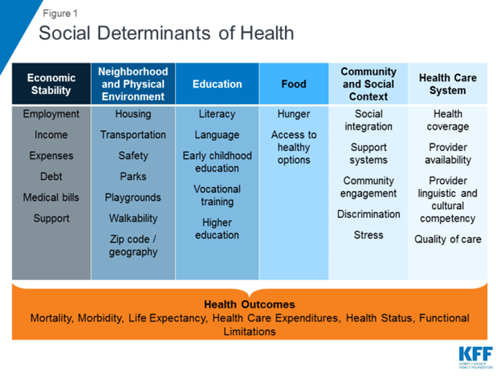
Community Health Needs Assessment Updates
Will be identifying areas for qualitative data collection
November - all action teams will discuss data from each social determinant of health category
We will meet with overall LCCP group in December to select CHNA priorities

Slide 6
National Drug Take-back Events
Hosted overall by the DEA
Any prescription meds can be taken
Vaping devices without the battery
No liquids or sharps
Three events in the county

Slide 7
National Drug Take-back Events
Laramie County Sheriff's Dept.
Saturday October 23, 2021
10am - 2pm
Fire Dept District #1
207 E. Allison Rd, Cheyenne, WY 82007
Burns Sub-station
301 S. Prairie Ave, Burns, WY 82053

Slide 8
National Drug Take-back Events
Pine Bluffs Police Department
Thursday, October 21
9 am - 2 pm
203 Main St.
Pine Bluffs, WY

Slide 9
GF2B
International Survivors of Suicide Loss Support Conference: ISOSL
SafeTALK training registration: SafeTALK
Question, Persuade, Refer training registration: QPR
Applied Suicide Intervention Skills training registration: ASIST
Peer Support, Grief and Caregivers support groups: Peer Support Groups
Volunteer registration form: Volunteer
Community Resource Guides by County

Slide 10
Rhianna Brand
Freshman Impact went well in Wheatland with Safe2Tell (September 29)
Over 150 students participated
QPR Train-the-Trainer to be held in Casper on November 1st, 8 am - 5 pm
Register here: https://forms.gle/cSJwqmNZ6MeVhNZj6
Wyoming Counseling Association presentation with Dominic Syracuse about the neuroscience of laughter in the brain, November 4th- 6th https://www.wyomingcounselingassociation.com/annual-conference/

Slide 11
LCSD #1
Olweus Bullying Questionnaire is being given throughout October to students 3 - 8th grade to measure students self-report on bullying.
Center for Safe Schools is hosting a webinar on October 21 from 1:00 - 2:30 pm on “Addressing a Student’s Call for Help Through Suicide Risk Assessment”. Register: http://thirdthursday.safeschools.info/?utm_source=mc&utm_medium=email&utm_campaign=april-tt
Office of Juvenile Justice and Delinquency Prevention is hosting a two day “Virtual Symposium: Understanding and Preventing Youth Hate Crimes and Identity-Based Bullying” on October 27-28 11 am - 3 pm both days. Register: https://ojjdp.ojp.gov/events/2021-virtual-symposium?utm_source=constant_contact&utm_medium=listserv_email&utm_campaign=hate-crimes-bullying-prevention

Slide 12
Agency Updates

Slide 13
CIT

